Slide 1
Big Mountain Resort Model Recommendations
Manthan Desai

Slide 2
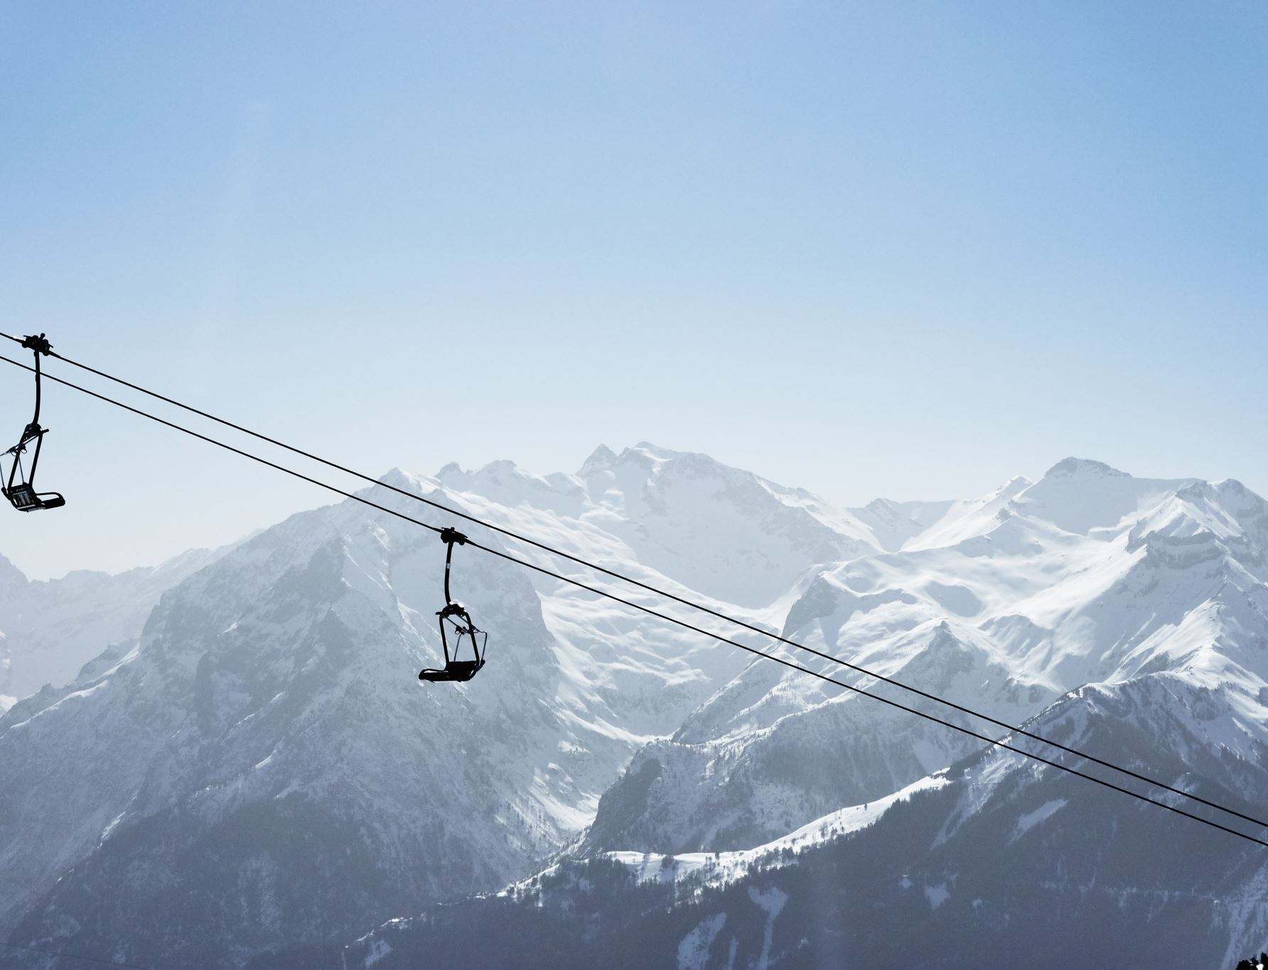
Problem Identification
What opportunities exist in operations or sales for the Big Mountain resort to maintain their annual profit margin of at least 10% in the upcoming tourist season given the increase in operating costs by $1.54 million dollars due to installation of the new chair lift?

Slide 3
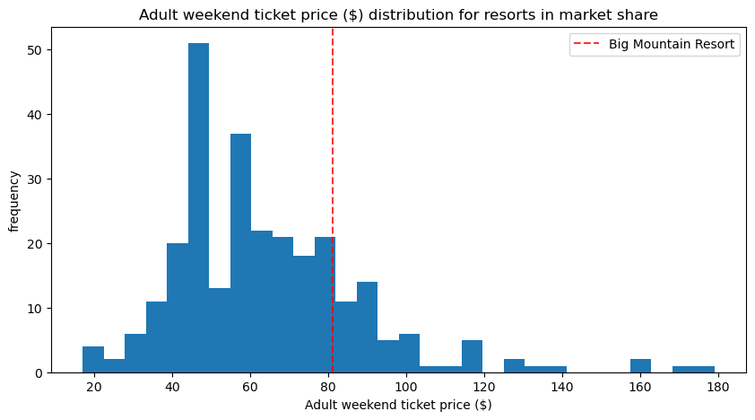
Key Findings & Recommendations
Three models considered: Mean, linear regressor, and random forest
Random Forest Model performed best according to the selection metrics
RF Model predicted a price of $95.87 with a mean absolute error of $10.39
Based on the current features of the resort, I recommend the weekend ticket price to be set to $85.50 for optimal value.

Slide 4
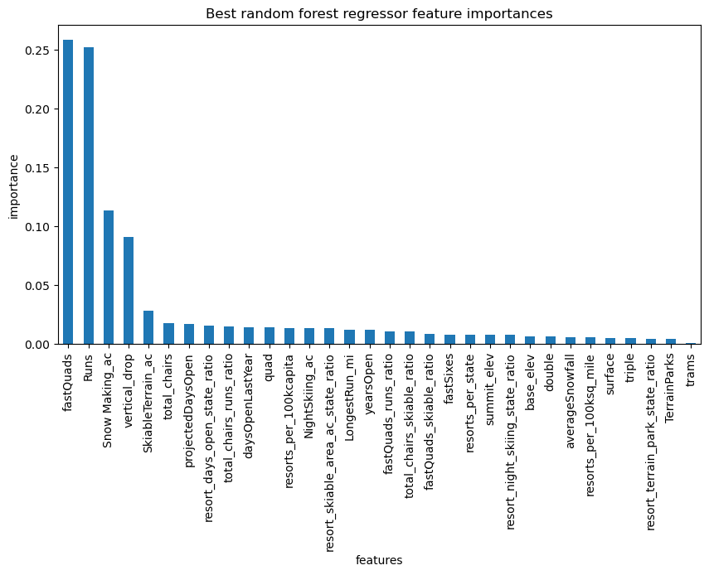
Modeling Results
The top four features determined by the Random Forest Model
fastQuads
Runs
Snow Making_ac
Vertical_drop

Slide 5
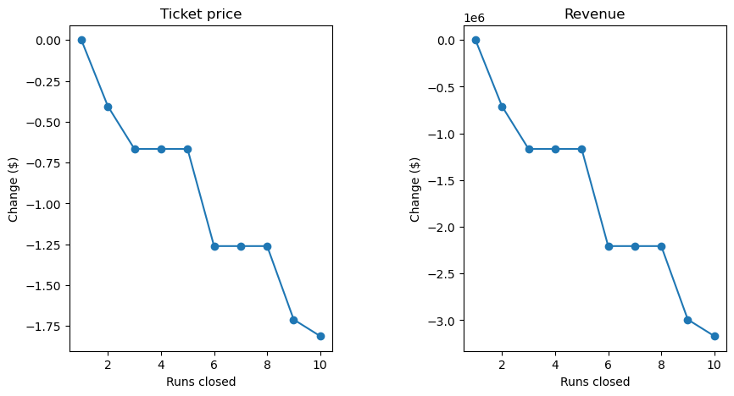
Modeling Results
Analysis of ticket price in relations to the number of runs closed was performed
Closing one run makes no difference
Closing 2 and 3 successively reduces support for ticket price
If closing 3 runs, it seems they may as well close 4 or 5 as there's no further loss in ticket price

Slide 6
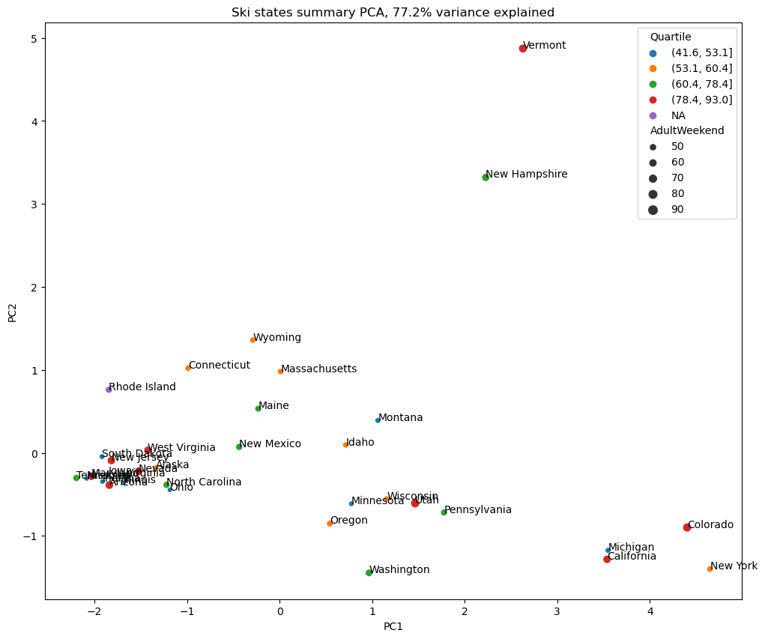
Modeling Results
Principal component analysis results
The state of a resort accounts for 77.2% variance in the data

Slide 7
Summary & Conclusion
Random Forest model chosen because of its performance on the dataset
Based on the available data, the optimal ticket price for Big Mountain resort is $85.50
Ways to improve the model
Incorporating data on operating costs for each resort in the current dataset allows for modelling of ticket price in relation to the features and their operating costs

